Slide 1
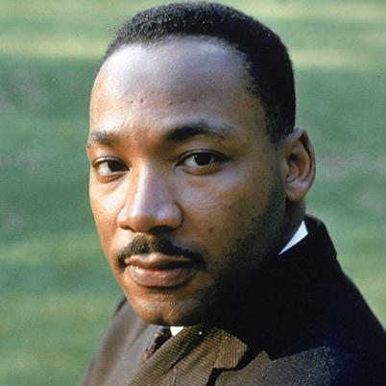
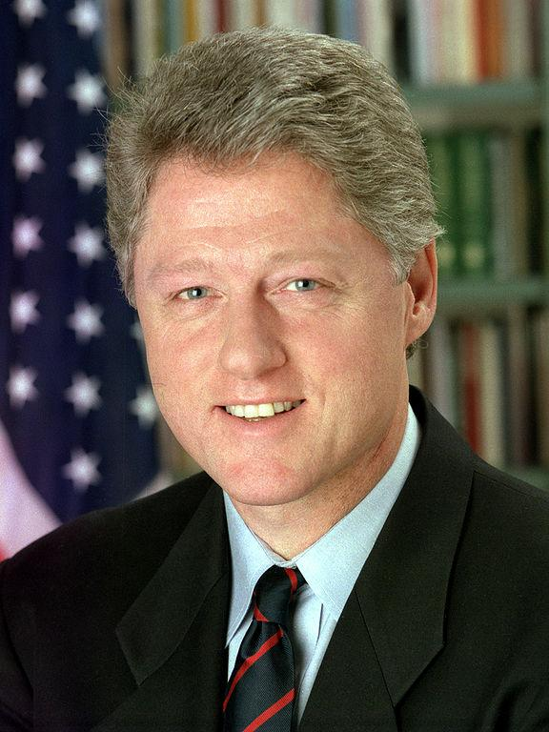
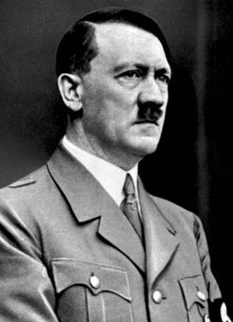
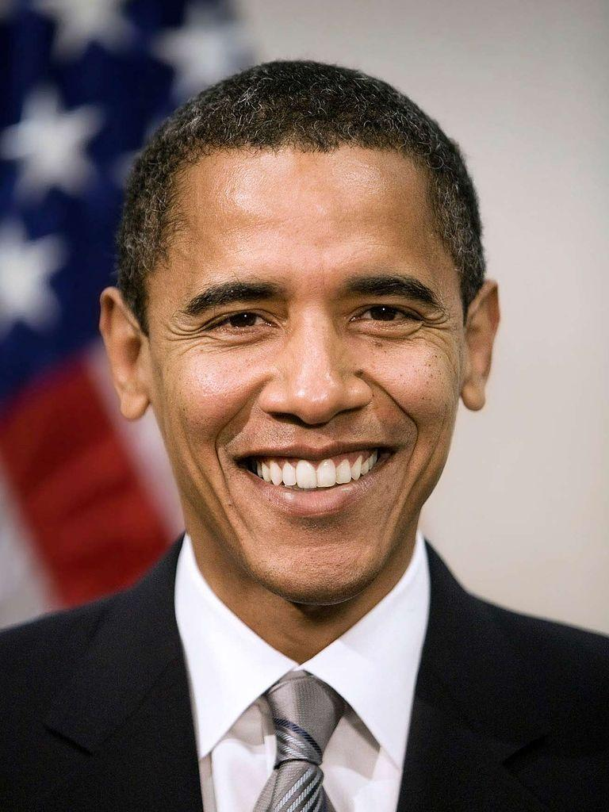

Slide 2
Understanding the Art of Rhetoric
Questions we will consider:
When and for what purposes do I use rhetoric in my life?
How does rhetoric change when my audience changes?
Is the use of rhetoric always ethical?
Why is it important that I learn how to use rhetoric?

Slide 3
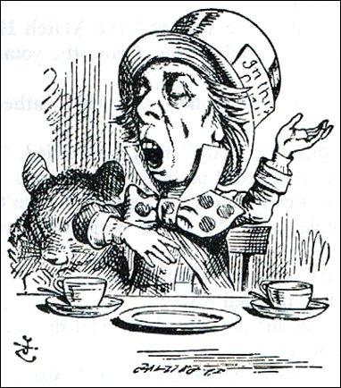
What is RHETORIC?
Definition:
The art of speaking or writing persuasively
When will you need to be persuasive?

Slide 4
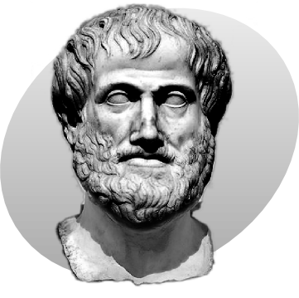
The real OG
The original greek we can thank for identifying the basic techniques of rhetoric is Aristotle.

Slide 5
Elements of Rhetoric
The Rhetorical Situation
Exigence/Speaker
Audience
Purpose
Message
Rhetorical Appeals
Logos
Pathos
Ethos
Surface Features
Diction
Syntax
Imagery
Figurative Language

Slide 6
How do you persuade others?
Activity: In small groups, you will create a commercial that attempts to sell us a product.
Requirements:
2-4 minutes
Script
Everyone has to have a role

Slide 7
Audience’s Job
For each commercial, take brief notes of the persuasive techniques used by each group.
What quotes/lines do you feel were meant to persuade you?
What actions or expressions do you feel contributed to the persuasiveness of this commercial?

Slide 8
Groups
Group 1: Rachel, Maddie, Bella
Group 2: Carter, Usman, Andrew
Group 3: Hannah, Katie W., Grace
Group 4: Bre, Jenna, Anne, Alayna
Group 5: Katie R., Kaili, Avery
Group 6: Leyna, Erica, McKenzie, Abbey
Group 7: Keely, Ellen, Allison

